Slide 1
UNIVERSITY INSTITUTE OF COMPUTING
MASTER OF COMPUTER APPLICATIONS
PYTHON PROGRAMMING
DISCOVER . LEARN . EMPOWER

Slide 2
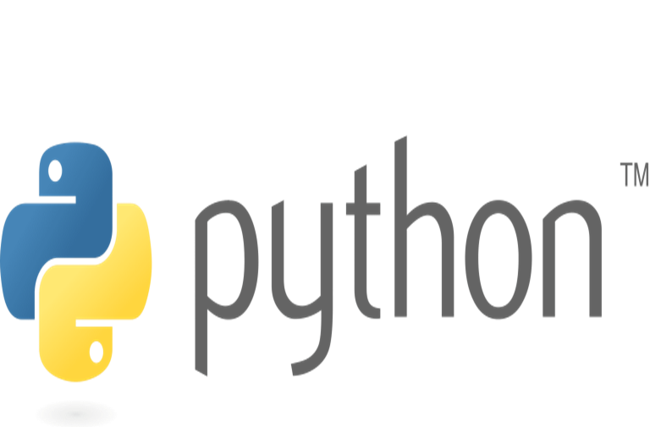
Contents
Python Data Structures
Lists
Tuple
Set
Dictionary

Slide 3
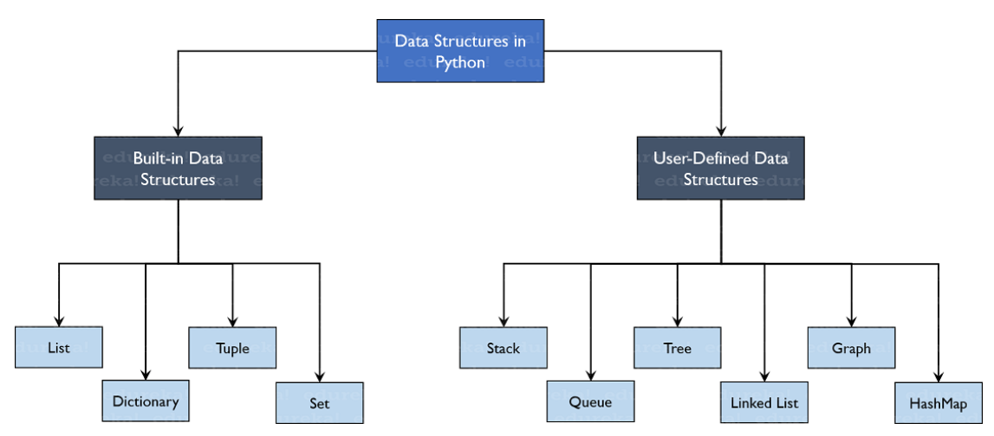
Python Data Structures
Data structures are code structures for storing and organizing data that make it easier to modify, navigate, and access information.

Slide 4
Python Data Structures
List: List is an ordered collection of elements enclosed within [].
A list can store a collection of data of any size.
A list is a sequence defined by the list class.
It contains the methods for creating, manipulating, and processing lists.
There are addresses assigned to every element of the list, which is called as Index.
Elements in a list can be accessed through an index.
Lists are mutable.
The elements in a list are separated by commas.
A list can contain the elements of the same type or mixed types.

Slide 5
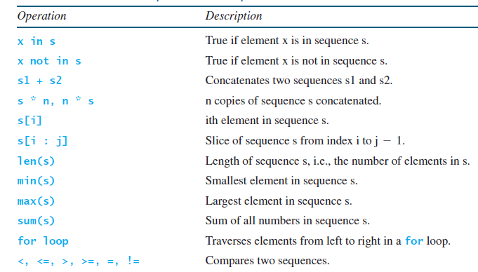
Python Data Structures
List Is a Sequence Type: Strings and lists are sequence types in Python. A string is a sequence of characters, while a list is a sequence of any elements.
Common Operations for Sequences

Slide 6
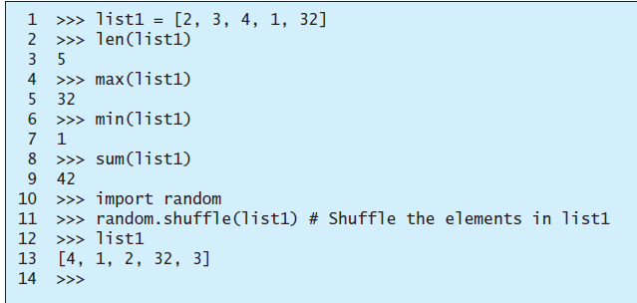
Python Data Structures
Functions for Lists: Several Python built-in functions can be used with lists.

Slide 7
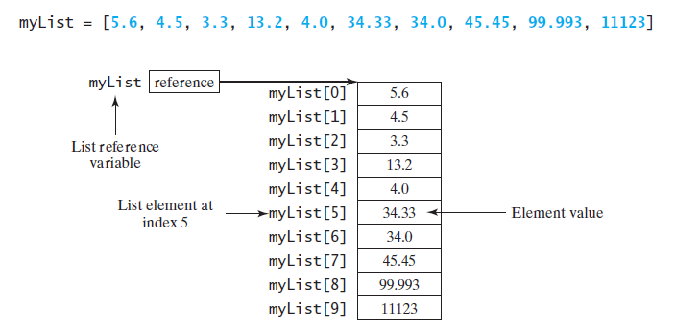
Python Data Structures
Index Operator []: An element in a list can be accessed through the index operator, using the following syntax:
myList[index]
List indexes are 0 based; that is, they range from 0 to len(myList)-1.
The list myList has 10 elements with indexes from 0 to 9.

Slide 8
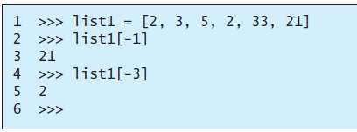
Python Data Structures
Python also allows the use of negative numbers as indexes to reference positions relative to the end of the list.
The actual position is obtained by adding the length of the list with the negative index. For example:

Slide 9
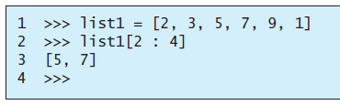
Python Data Structures
List Slicing [start : end]: The index operator allows you to select an element at the specified index. The slicing operator returns a slice of the list using the syntax list[start : end]. The slice is a sublist from index start to index end – 1. Here are some examples

Slide 10
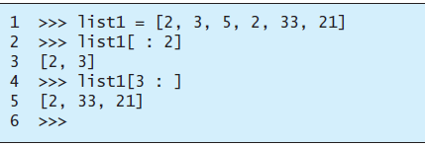
Python Data Structures
List Slicing [start : end]

Slide 11
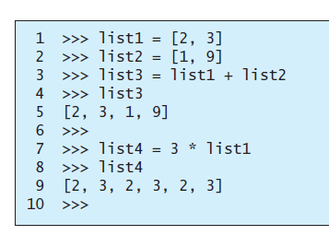


Python Data Structures
The +, *, and in/not in Operators:

Slide 12
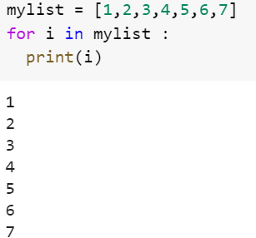
Python Data Structures
Traversing Elements in a for Loop: The elements in a Python list are iterable. Python supports a convenient for loop, which enables you to traverse the list sequentially without using an index variable. For example, the following code displays all the elements in the list myList:
for u in myList:
print(u)

Slide 13
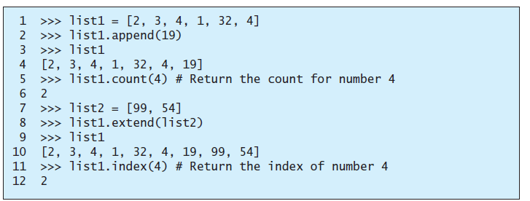
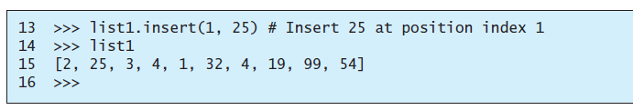
Python Data Structures
List Methods: append, count, extend, index, and insert methods

Slide 14
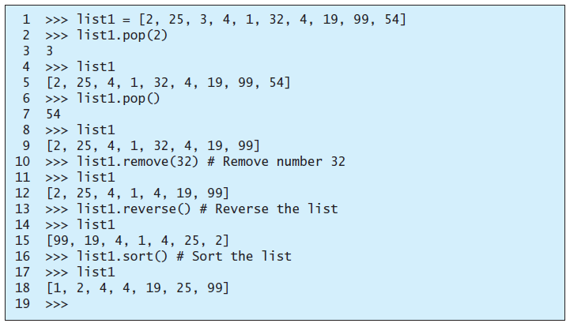
Python Data Structures
List Methods: insert, pop, remove, reverse, and sort methods

Slide 15
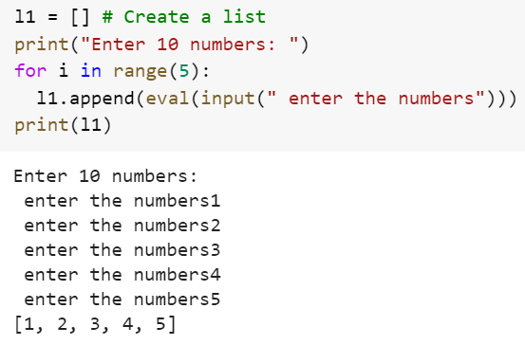
Python Data Structures
Inputting Lists

Slide 16
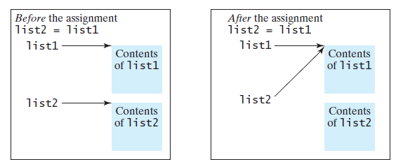
Python Data Structures
Copying Lists: To copy the data in one list to another list, you have to copy individual elements from the source list to the target list.
You often need to duplicate a list or part of a list in a program. In such cases you could attempt to use the assignment statement (=), as follows:
list2 = list1

Slide 17
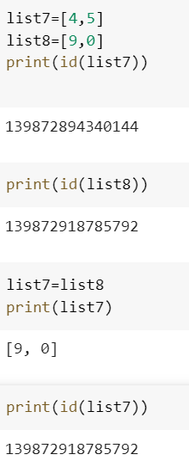
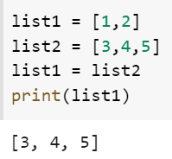
Python Data Structures
list2 = list1

Slide 18
Python Data Structures
Tuples : Tuples are like lists, but their elements are fixed; that is, once a tuple is created, cannot add new elements, delete elements, replace elements, or reorder the elements in the tuple. Tuple is immutable.
A tuple is very much like a list, except that its elements are fixed.
It is enclosed within ().

Slide 19
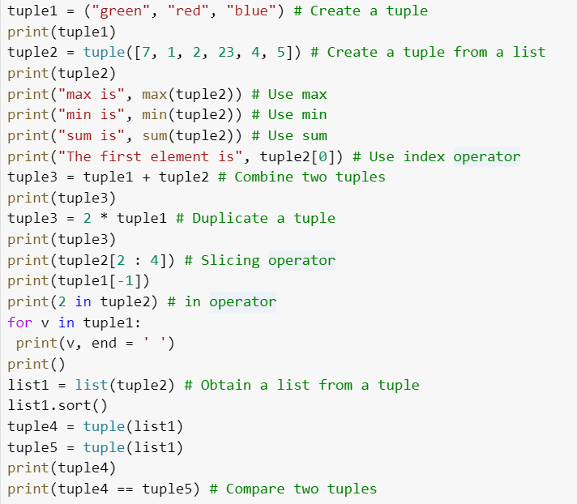
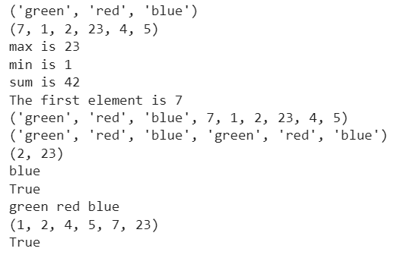
Python Data Structures

Slide 20
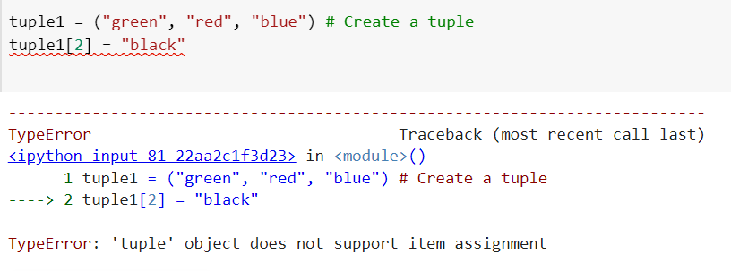
Python Data Structures
Cannot modify a tuple because it is immutable.

Slide 21
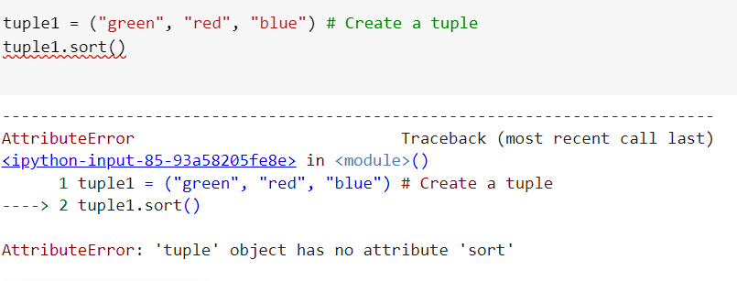
Python Data Structures
Cannot modify a tuple because it is immutable.

Slide 22
Python Data Structures
Sets : Sets are like lists storing a collection of elements.
Unlike lists, however, the elements in a set are nonduplicates and are not placed in any particular order.
It is enclosed within { }.
A set can contain the elements of the same type or mixed types.
For example, s ={1, 2, 3, "one", "two", "three"} is a set that contains numbers and strings.
Set items are unchangeable, but you can remove items and add new items.
Sets cannot have two items with the same value.

Slide 23
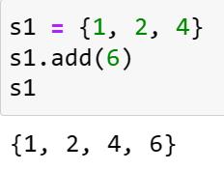
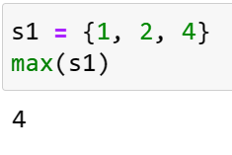
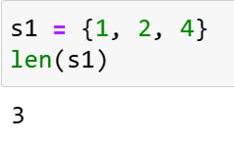
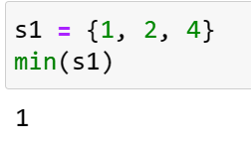
Python Data Structures
Manipulating and Accessing Sets: Add an element to a set or remove an element by using the add(e) or remove(e) method. You can use the len, min, max, and sum functions on a set, and a for loop to traverse all elements in a set.
Use in or not in operator to determine whether an element is in the set.

Slide 24
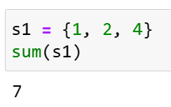
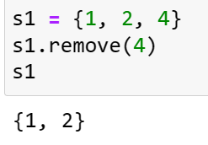
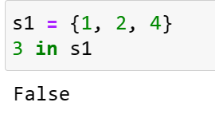
Python Data Structures
Manipulating and Accessing Sets
The remove(e) method will throw a KeyError exception if the element to be removed is not in the set.

Slide 25
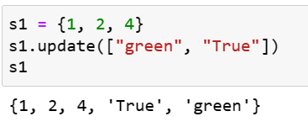
Python Data Structures
Manipulating and Accessing Sets

Slide 26
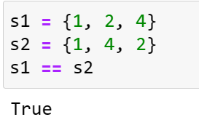
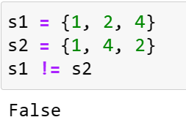
Python Data Structures
Equality Test: the == and != operators to test if two sets contain the same elements. For example:

Slide 27
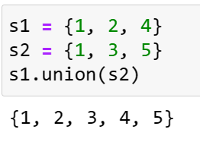
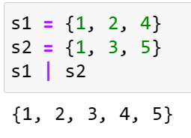
Python Data Structures
Set Operations: Python provides the methods for performing set union, intersection, difference, and symmetric difference operations.
The union of two sets is a set that contains all the elements from both sets.
Use the union method or the | operator to perform this operation. For example:

Slide 28
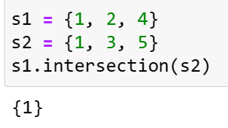
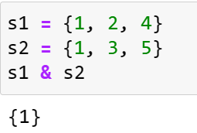
Python Data Structures
Set Operations: Python provides the methods for performing set union, intersection, difference, and symmetric difference operations.
The intersection of two sets is a set that contains the elements that appear in both sets. Use the intersection method or the & operator to perform this operation. For example:

Slide 29
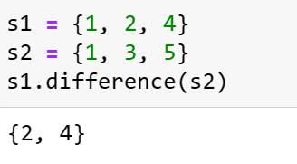
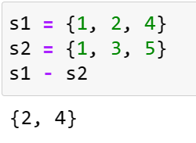
Python Data Structures
Set Operations: Python provides the methods for performing set union, intersection, difference, and symmetric difference operations.
The difference between set1 and set2 is a set that contains the elements in set1 but not in set2. Use the difference method or the - operator to perform this operation.
For example:

Slide 30
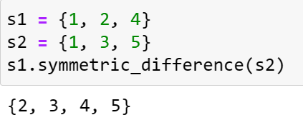
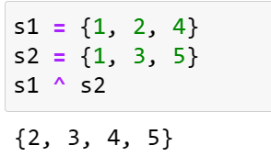
Python Data Structures
Set Operations: Python provides the methods for performing set union, intersection, difference, and symmetric difference operations.
The symmetric difference (or exclusive or) of two sets is a set that contains the elements in either set, but not in both sets. You can use the symmetric_difference method or the ^ operator to perform this operation. For example:

Slide 31
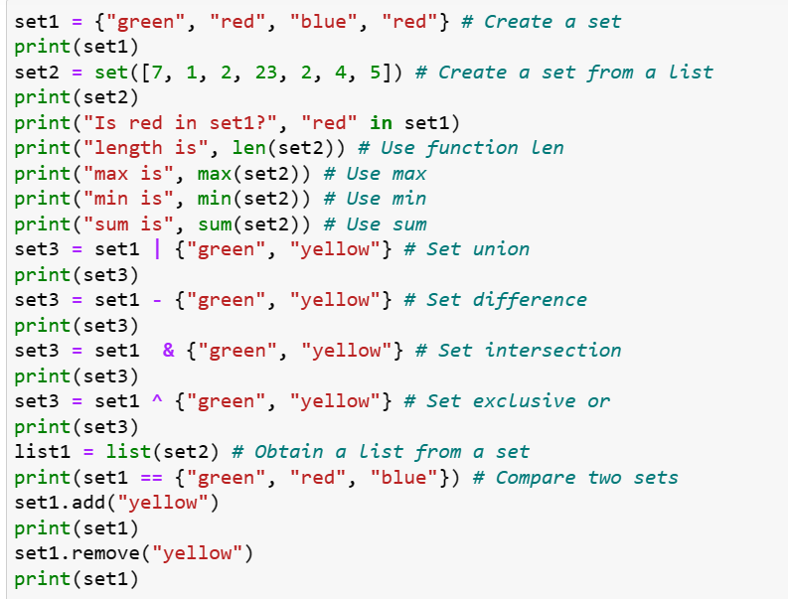
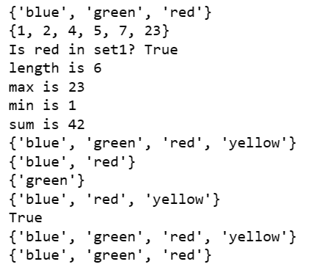
Python Data Structures

Slide 32
Python Data Structures
Dictionaries: A dictionary is a container object that stores a collection of key/value pairs.
It enables fast retrieval, deletion, and updating of the value by using the key.
A dictionary is an efficient data structure for such a task.
A dictionary is a collection that stores the values along with the keys. The keys are like an index operator.
A dictionary cannot contain duplicate keys. Each key maps to one value.
A key and its corresponding value form an item (or entry) stored in a dictionary.

Slide 33
Python Data Structures
Dictionaries: The data structure is a called a “dictionary” because it resembles a word dictionary, where the words are the keys and the words’ definitions are the values.
A dictionary is also known as a map, which maps each key to a value.
Dictionary is mutable.
Creating a Dictionary: Create a dictionary by enclosing the items inside a pair of curly braces ({}). Each item consists of a key, followed by a colon, followed by a value. The items are separated by commas.

Slide 34
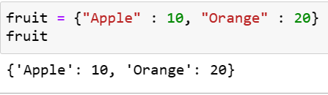
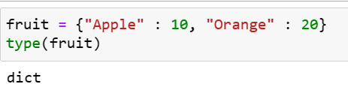
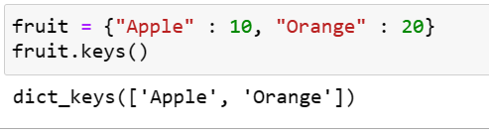
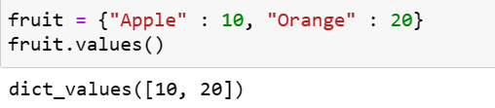
Python Data Structures

Slide 35
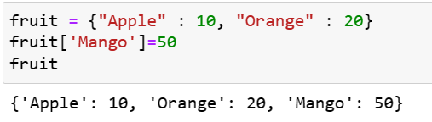
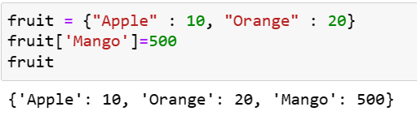
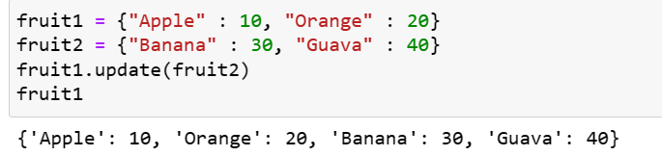
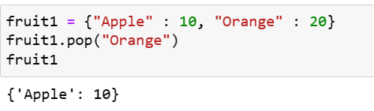
Python Data Structures
Adding a new element, changing an existing element, update, pop

Slide 36
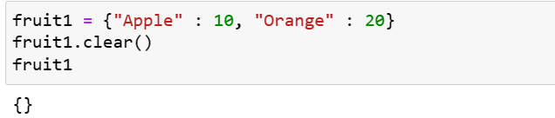
Python Data Structures
Adding a new element, changing an existing element, update, pop, clear

Slide 37
Python Data Structures
Difference between list, tuple, set and dictionary
List | Tuple | Set | Dictionary
List is a non-homogeneous data structure that stores the elements in single row and multiple rows and columns | Tuple is also a non-homogeneous data structure that stores single row and multiple rows and columns | Set data structure is also non-homogeneous data structure but stores in single row | Dictionary is also a non-homogeneous data structure which stores key value pairs
List can be represented by [ ] | Tuple can be represented by ( ) | Set can be represented by { } | Dictionary can be represented by { }
List allows duplicate elements | Tuple allows duplicate elements | Set will not allow duplicate elements | Set will not allow duplicate elements and dictionary doesn’t allow duplicate keys.

Slide 38
Python Data Structures
Difference between list, tuple, set and dictionary
List | Tuple | Set | Dictionary
List can be created using list() function | Tuple can be created using tuple() function. | Set can be created using set() function | Dictionary can be created using dict() function.
List is mutable i.e we can make any changes in list. | Tuple is immutable i.e we can not make any changes in tuple | Set is mutable i.e we can make any changes in set. But elements are not duplicated. | Dictionary is mutable. But Keys are not duplicated.
Creating an empty list l=[] | Creating an empty Tuple t=() | Creating a set a=set() | Creating an empty dictionary d={}

Slide 39
THANK YOU

